Slide 1


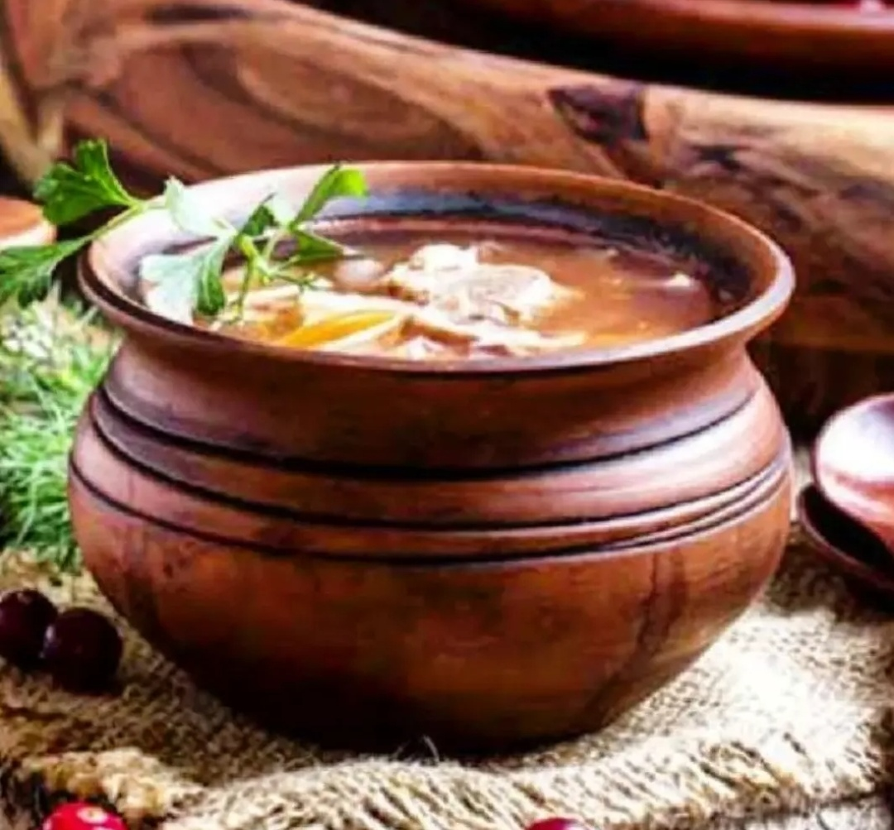
M.D.K
MITTI DI KHUSHBU
…Enjoy the Best
Culinary Taste…
C 101 Mayapuri, Phase-2 Near Crystal Palace Banquet

Slide 2
M.D.K
MITTI DI KHUSHBU
Enjoy the Best
CULINARY TASTE
C 101 Mayapuri, Phase-2 Near Crystal Palace Banquet

